Slide 1

Computer Networks Module 2
By
Dr. Kanchan Shende

Slide 2
OSI Model – Conti….
Application Layer
FTAM, Mail Services and Directory Services.
Presentation Layer
Translation, Encryption and Compression.
Session Layer
Dialog control and Synchronization.
Transport Layer
Port Addressing, Segmentation and Reassembly, Connection Control, Flow Control and Error Control
Network Layer
Logical Addressing and Routing.
Data Link Layer
Framing, Physical Addressing, Flow Control, Error Control, and Access Control.
Physical Layer
Physical characteristics of the media, Representation og bits, Data rate, Synchronization of bits, Line configuration, Physical topology and Transmission mode.
SoCS, MIT-WPU

Slide 3
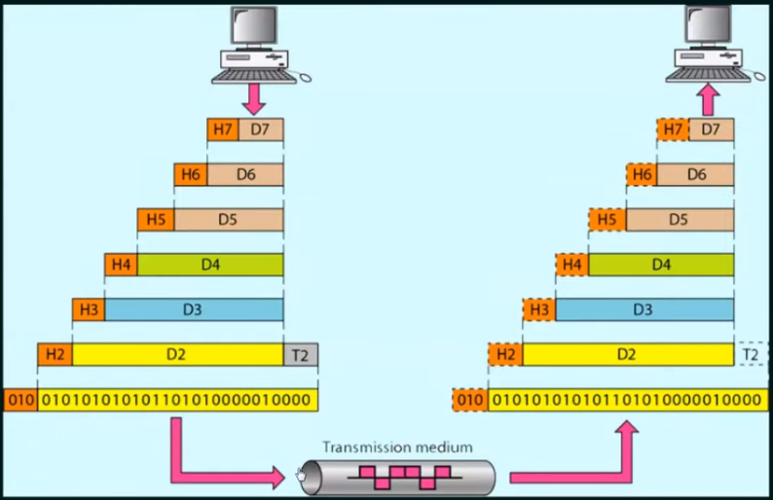
Working of the OSI reference model
SoCS, MIT-WPU

Slide 4
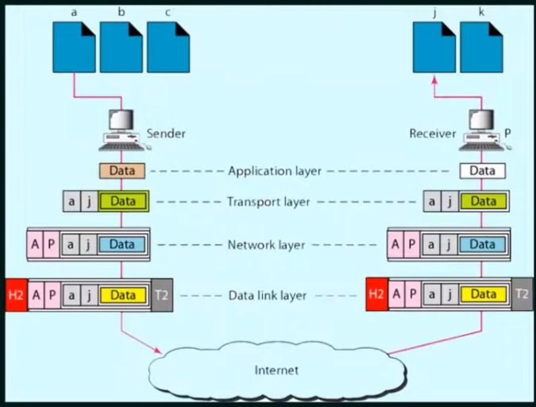
Conti….
SoCS, MIT-WPU

Slide 5
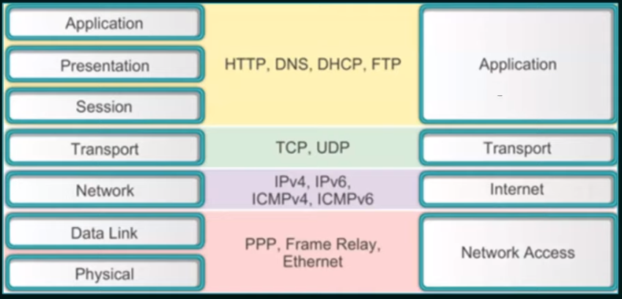
OSI Reference Model vs TCP/IP Reference Model
SoCS, MIT-WPU

Slide 6
TCP/IP Reference Model
Application Layer
Represents data to the user, plus encoding and dialog control
Transport Layer
Supports communication between diverse devices across diverse networks
Internet Layer
Determines the best path through the network
Network Access Layer
Controls the hardware devices and media that make up the network
SoCS, MIT-WPU

Slide 7
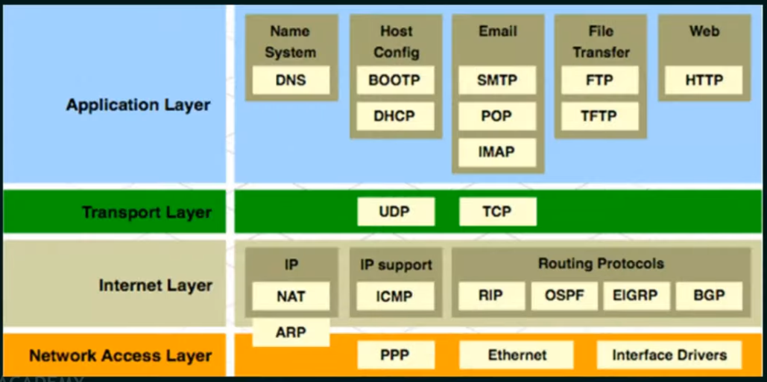
TCP/IP Reference Model
SoCS, MIT-WPU

